Slide 1

Professional Presentation Strategies

Slide 2
Outline
General Guidelines
Slide Do’s and Don’ts
Handouts
PowerPoint Navigation
Delivery Do’s and Don’ts
How to Handle Questions
Final Thoughts

Slide 3
Why are presentation skills important?
Job Hunting
Academia
Conferences, Seminars, Teaching classes
Industry
Training, Project Reports, Reports to Management
Other
politics, fund raising, community service, etc.

Slide 4
General Guidelines
A good presentation is a “POPTA” presentation
What does POPTA stand for?

Slide 5
General Guidelines
Purpose
You need to define your purpose for giving the presentation
To inform,
To persuade,
To demonstrate
Teach, Persuade, Prove, Review, Impress, Entertain

Slide 6
Analysis of Audience
A- Audience
U- Understanding
D- Demographic information
I- Interest
E- Environment
N- Needs
C- Customized
E- Expectations

Slide 7
Analyze the Occasion
Analysis of Local
Event (National or International)
Venue
Technical devises
Time
Sponsors

Slide 8
Selection of Topic
Occasion
Purpose
Audience
Focus of the presentation
Completeness
Focused title

Slide 9
Preparing the Presentation
Develop the central Idea
Core idea or thesis of statement
Declarative sentence
Audience centered ideas
Accuracy of content
Specific language

Slide 10
Develop the main Ideas
Logical division of Central Idea
Factual Information
Support the central Idea
Examples
Data, Tables, Graphs
References

Slide 11
Supporting Material
References
Library, Internet
Laboratory
Interviews & Discussions
Questionnaire
Observations

Slide 12
Visual Aids
Purpose of adding visual aids
To serve as speech note
To focus on the theme of the presentation
To increase audience interest
To maintain clarity and precision

Slide 13
Types of Visual Aids
Objects , Models, People
Drawings, Photographs,
Slides, Maps, Graphs (Bar graphs, Pie graphs, Line graphs, Picture Graphs)
Charts
Overhead transparencies
Chalkboard

Slide 14
General Guidelines
Organization
Always have an outline
Introduction, Main Body and Conclusion
Catchy beginning
Impressive conclusion
Careful selection of points/ideas

Slide 15
General Guidelines
Preparation
An unprepared presenter loses the audience before even starting
Practice makes perfect and builds confidence
Arrive early, make sure everything is set up
Dress appropriately
Slides should be done well in advance

Slide 16
General Guidelines
Time
Be sure you know how much time you have while preparing the presentation
You’ll never have enough time to tell everything so stick to the most important

Slide 17

General Guidelines
Audience
Be sure you know your audience well
Trailer presentation to your audience
Failure to do this is probably the biggest mistake people make
Watch the audience for clues

Slide 18
“Power Point doesn’t give presentations – Power Point makes slides”
www.microsoft.com

Slide 19
Slide Do’s and Don’ts
Make sure your slide corresponds
Don’t clutter
Don’t put periods at the end of a bullet (.)
Make each slide stand on its own
Generally 1 main point for each slide
Use animation
Don’t overuse it
Makes it difficult and annoying to navigate

Slide 20
Slide Do’s and Don’ts
Do Put a caption on every graph/picture/table

Slide 21
Slide Do’s and Don’ts
Don’t use yellow text
Do use dark text and bold
Do use formatting and color to emphasize (e.g. POPTA)
Don’t include unrelated pictures

Slide 22
Slide Do’s and Don’ts
Don’t do serif fonts (like Times New Roman)
Do use sans serif fonts (like Arial)
or Tahoma

Slide 23
Slide Do’s and Don’ts
Do chek yor speling for mestakes
Typos instantly destroy credibility and convey lack of preparation
Do have someone else read through presentation

Slide 24
Slide Do’s and Don’ts
Do use a light background like this

Slide 25
Slide Do’s and Don’ts
Or like this

Slide 26
Slide Do’s and Don’ts
Or like this

Slide 27
Slide Do’s and Don’ts
Don’t use a dark background like this
Even if using a lighter font color
Harder to read, especially from the back
More likely to put people asleep
Handouts often don’t look very good

Slide 28
Slide Do’s and Don’ts
Surveys
Quizzes
Videos
Physical Objects
Etc.
Do use occasional “spice” or “pace breakers”
Humor
Pictures
Sound
Animation
Questions (Not just
Yes/No)
For example . . .
A pace breaker can do this for your audience

Slide 29
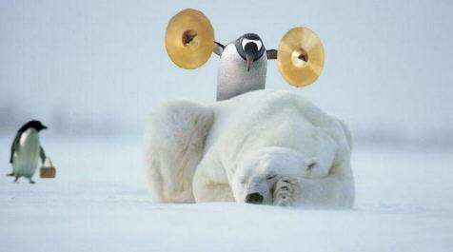

Slide 30
Handouts
Use them if they help achieve your objective
Especially for technical presentations
Greatly increases retention
Often best to pass out at the end
You want to keep the audience engaged

Slide 31
A pace-breaker can do this for your audience

Slide 32
Handouts
Use them if they help achieve your objective
Especially for technical presentations
Greatly increases retention
Often best to distribute at the end
You don’t want to loose the audience

Slide 33
Delivery Do’s and Don’ts
Don’t read or “parrot” the slides
Otherwise, why give a presentation?
Use the slides as a cue
Let the audience read
Use the pointer sparingly

Slide 34
Delivery Do’s and Don’ts
Do relax, use nerves to your advantage
Breathe deeply, pause as needed
Don’t go too fast
Do watch out for mannerisms
“Um . . um”
Do empty your pockets and hands
Make cue cards

Slide 35
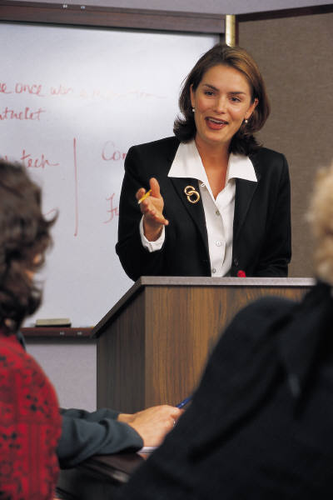
Delivery Do’s and Don’ts
Use body language to help make a point
Purposeful movements
Use appropriate posture
Don’t slouch
Sitting implies informality
Move around if possible
Don’t pace
Don’t be hyperactive
Center yourself, rearrange setup if needed

Slide 36
Delivery Do’s and Don’ts
Face the audience more than slides
Don’t talk to the screen or wall
Add variety to your voice
Don’t speak in a monotone
Adjust volume and pace
Articulate clearly
Wear a pleasant expression ☺

Slide 37
Handling Questions
Welcome them
Lots of questions are either a sign of:
Interest in what you are talking about
Failure to communicate an idea
Always repeat the question
For you to make sure you understood it
For audience to make sure they heard it

Slide 38
Handling Questions
Answer the question to the audience
Then check back to the individual for confirmation
Don’t be afraid to say “I don’t know”
Better than mumbling or fumbling on an answer

Slide 39
Final thoughts
Good slides go a long way
Practice, practice, practice
Remember that the audience wants you to succeed
Use different sources (books, web, experts)
Everyone can learn to be a good presenter

Slide 40
THANK YOU

